Slide 1
Introduction To F#

Slide 2




Stephen Peterson
Stephen.Peterson@nasdaq.com
Twitter: @steverpeterson

Slide 3
What’s on the menu…
A bit about F#
OOP (C#) vs F#
It’s not all hot air (code examples)
F# Resources
Conclusion

Slide 4
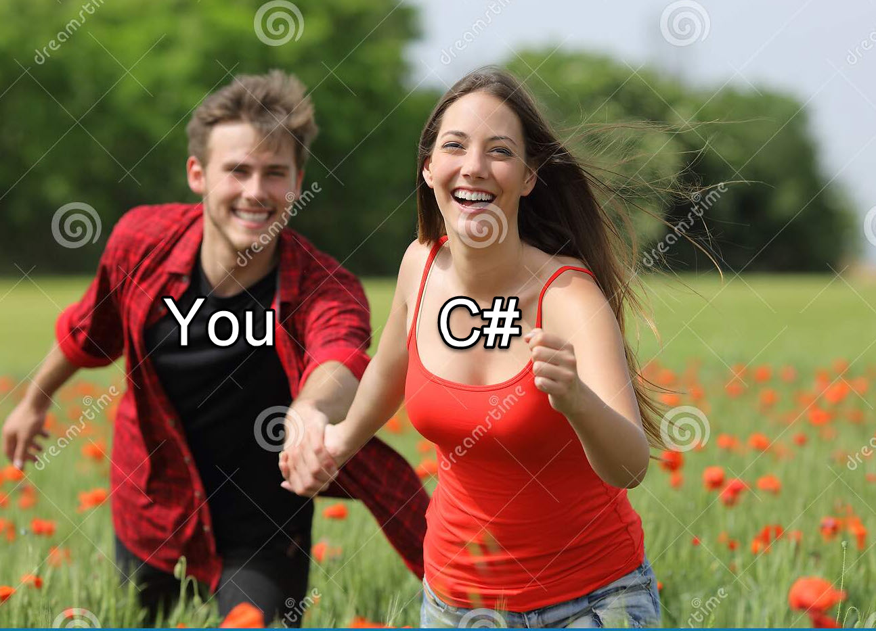

Slide 5

A bit about F#
First shipped with Visual Studio 2010
First class citizen of the .NET language family
Is a functional first language
Is open source
Fully interoperable with C# libraries and vice versa

Slide 6






Some companies using F#…

Slide 7

Comparing OOP (C#) to F#
Object Oriented (OOP)
Mutable by default
Null allowed
Reference type equality
No dependency order
Functional first language
Immutable by default
Null is not allowed
Value type equality
Enforced dependency order
More to come…

Slide 8
Comparing C# to F#
Imperative
Classes for data and behavior
Interfaces
Inheritance
Declarative
Types for data
Function Type
Nope!! Open what ya need!
Not done yet…

Slide 9
Comparing C# to F#
Huh???
No clue, sir!
What the…???
No way!! Really???
Drawing a blank here, man!
Algebraic Type System (And/Or)
Option Type (Some/None)
Result Type (Ok/Error)
Units of Measure
Script (.fsx) files
On to actual examples…!

Slide 10
Soo.. Why F#?
Never have to worry about nulls!
Self documenting code
F# Interactive allows you to test code as you write it
Less code with fewer bugs
Fully interoperable with C# and vice versa
Bottom line for all the bean counters: Cheaper!!!

Slide 11
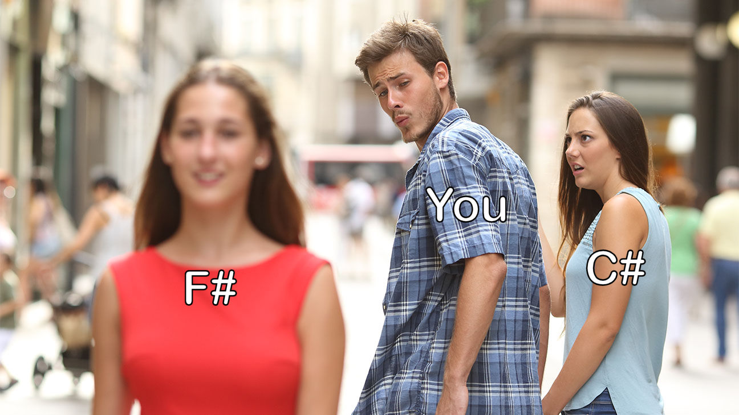

Slide 12
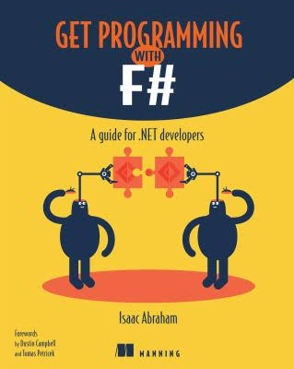
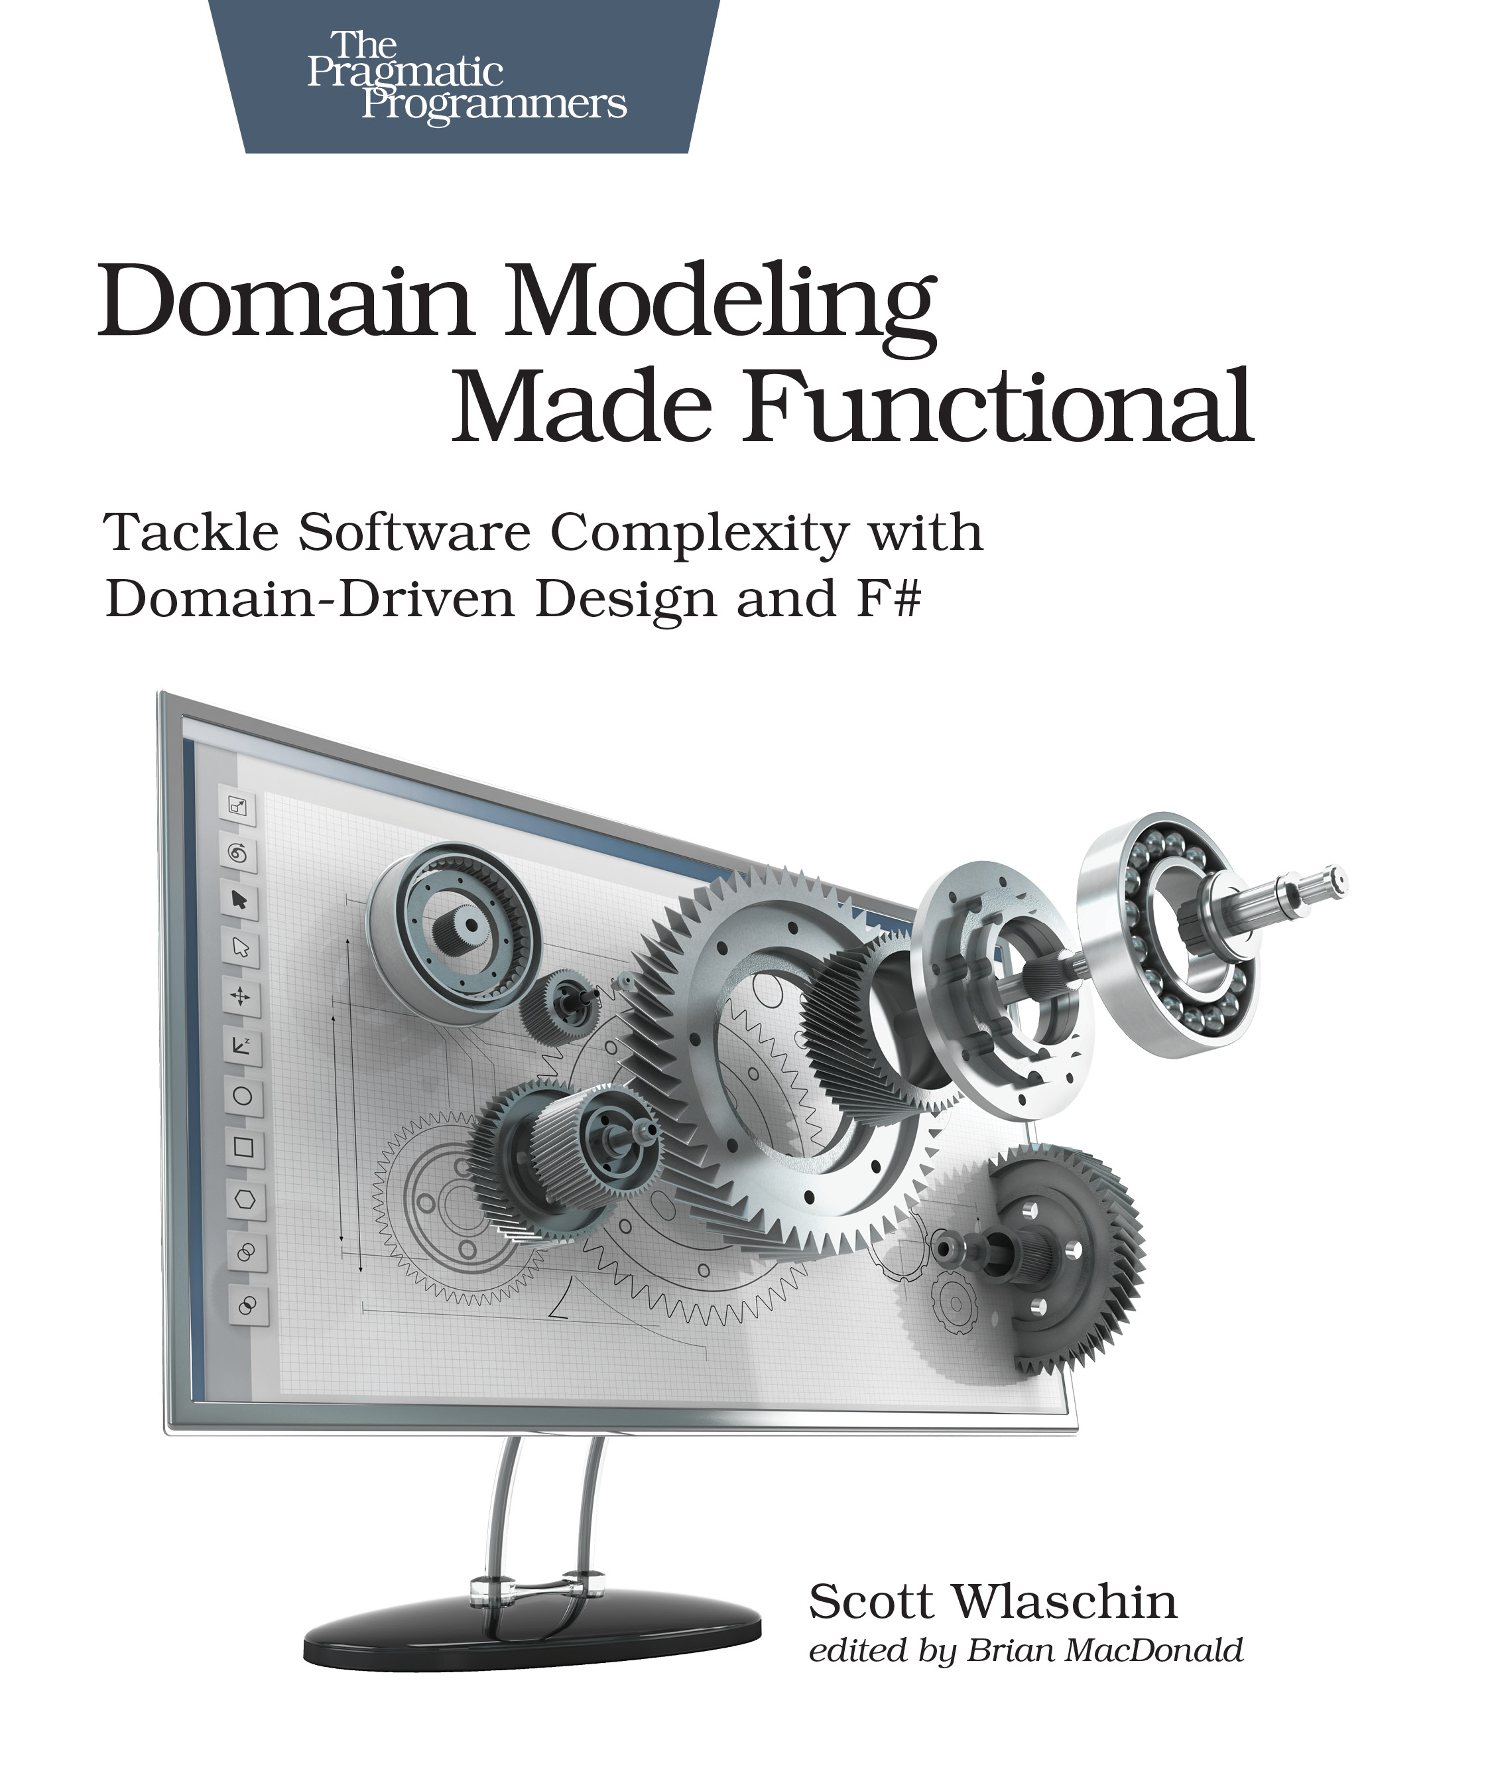
F# Resources - Books
Get Programming with F#
Domain Modeling Made Functional
Isaac Abraham
Scott Wlashin

Slide 13
F# Resources - Online
https://fsharp.org/ - Official F# site with mentorship program
https://exercism.io/ - Online training with a mentor
https://fable.io/repl/ - Online REPL with code samples
https://fsharpforfunandprofit.com/ - Scott Wlashin’s F# learning site
Google – just do a search for “Learn F#”

Slide 14
Thank you!!!

